Slide 2
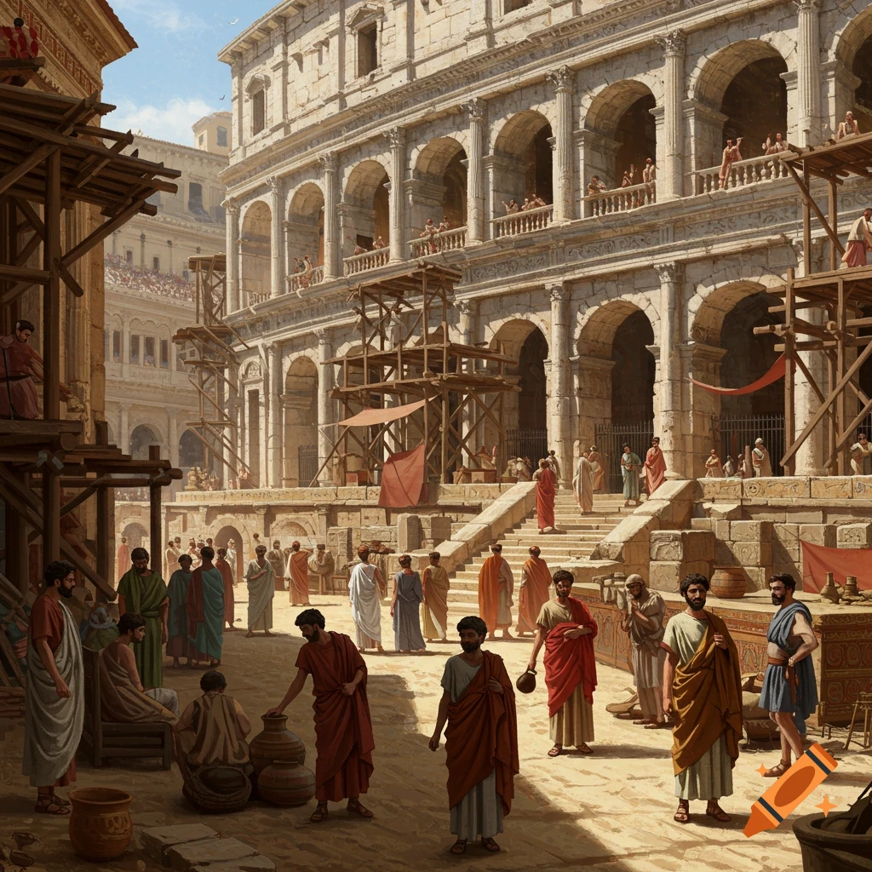
Ancient Churches in Modern Times
Jerusalem

Slide 3
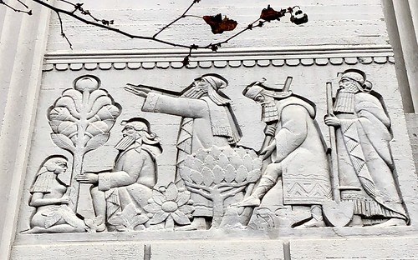
Devoted to Word & Worship
Apostles Doctrine
Breaking of bread and prayers
Just regular people

Slide 4

Devoted to Each Other
Cultural
or Biblical?
Kingdom Fellowship
4:32 “…those who believed were of one heart and soul, and no one said that any of the things that belonged to him was his own, but they had everything in common.”

Slide 5
Trouble In Paradise
Apostles beaten, Ananias and Sapphira, Widows, Stephen, Saul, Cornelius, Famine, James, False teachers, Riots

Slide 6
Ancient Churches in Modern Times do we…
Obey God or man? Acts 4:19-20
Look to eternity 1 Peter 1:6-9

